Slide 1
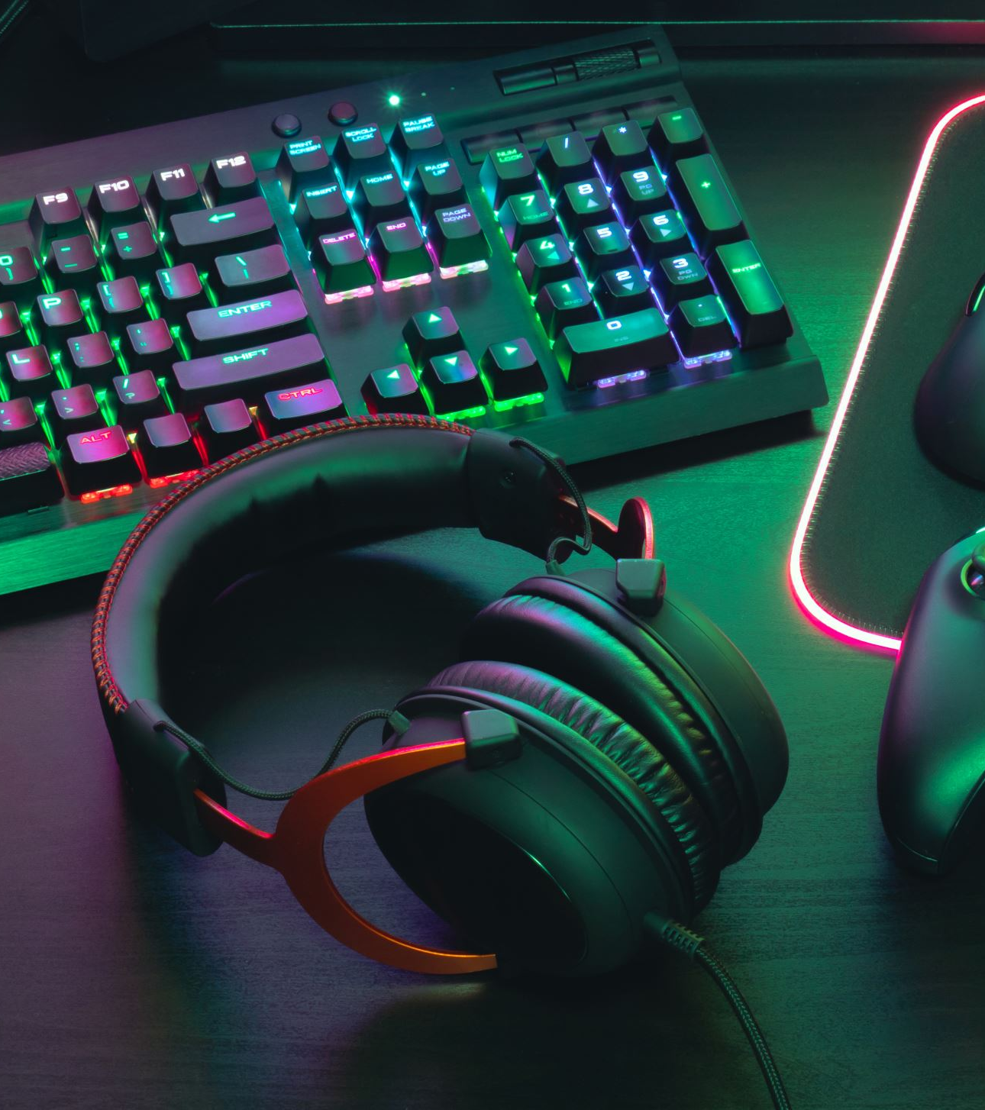
VR SETUP in UNITY

Slide 2
Step 1
Open new project
3D / URP / VR Template

Slide 3
Step 2: Installing package
XR interaction toolkit
Edit->project settings->Install XR plugin management
Select VR device

Slide 4
Step 3: Add a plane
Transform settings : Position (0,0,0) and Rotation (0,0,0)
Change the material of plane to black

Slide 5
Step 4: Camera
Delete main camera
Create a play zone :
Create a empty object (VR Rig)[(0,0,0),(0,0,0),(1,1,1)]
Add component XR Rig/XR origin
Create a child object under VR Rig (Camera offset)
Create a child object under Camera offset (VR Camera) [Player eyes]
Add a component (Tracked pose driver)
Select pose source – Centre eye
GoTo VR Rig object
Add camera offset to Camera floor offset project
Add VR camera to camera game object
Choose track origin mode : Floor

Slide 6
Step 5: Controllers
GoTo camera offset
Add child object: Left Hand
Add child object: Right Hand
Add component to both child object : XR Controller
Change controller node in both the object
Add model prefab in the controllers
Add a cube
Make it as prefab
Add the prefab to XR controller component of both objects

Slide 7
Step 6: Managing controllers
Add any 3D object as child of both controllers
Remember to remove box collider from 3D objects

Slide 8
Step 7: Downloading packages for controllers
Download package from this link : click here
GoTo Oculus foder -> Prefab
Drag and drop the hand prefab to left and right controller accordingly.

Slide 9
Step 8: Animations
Select any of the controller’s hand
GoTo Window -> Animations
GoTo Blendtree
Here you can change Grip and trigger values which will be reflected in animations

Slide 10
Step 9: Change the color of hand
GoTo child of hand models and select its child (hands:Lhand / hands:Rhand)
GoTo Skinned Mesh Renderer in inspector settings
Change Hands_Solid Material shade to standard and then change the color.

Slide 11
Step 10: Read and use an input
Adding scripts to controllers
Select any controller’s hands
Add component and name it accordingly

Slide 12
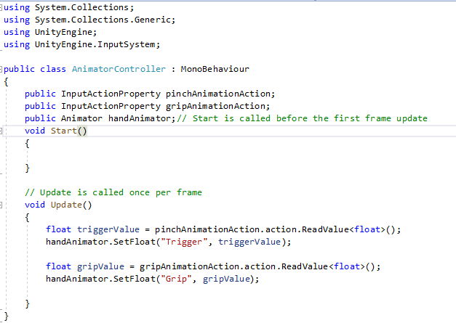

Slide 13
Step 11: Adding animation
Enable “use reference” in inspector settings.
Select XRI controllers from start assets
Drag animator to HandAnimator in inspector settings

Slide 14
For Pinch Action Animation Action
Enable use reference
Select XRI Left/RightHand Interaction Activate value
For grip Animation Action
Enable use reference
Select XRI Left/RightHand Interaction Select value

Slide 15
Step 12: Movement
Select VR Rig
Add components:
Locomotion system
Drag and drop XR origin to XR origin variable
Continuous move provider (Action-based)
Drag Locomotion system to system variable
Drag VR camera to Forward source variable
Check if actions are added or not
Character controller

Slide 16
Step 13: Rotation
Select VR Rig
Add component : Continuous Turn Provider
Add locomotion system
Add action
Add component : Character controller Driver
Drag and drop VR Rig to Locomotion provider variable

Slide 17
Step 14: Teleport
Right Click on camera offset -> XR -> Ray Interaction XR Action based
Name it as Left/Right teleportation ray
Select VR rig
Add component: Teleportation provider
Add component: Teleportation area

Slide 18
Step 15: Teleportation anchor
Create a plane
Create an empty object (name it as Teleportation anchor)
Create a cylinder as its child
Change the material of cylinder
Make the material transparent
Change the transform setting of cylinder (0,1,0),(0,0,0),(1,1,1)
Select Teleportation anchor
Add component “Teleportation anchor”
In collider variable in inspector settings drag and drop Cylinder object.
Drag and drop teleportation anchor game object to Teleport Anchor transform variable
Duplicate/triplicate the teleportation anchor object and change their position
Add Reticle to left/right hand ray
Drag and drop the reticle to reticle variable in XR Interactor Line Visual

